Slide 1
MINI PROJECT
Present by Team 11

Slide 2
Group 11 members:
Nguyễn Quang Hưng 20214961
Phạm Đức Thành 20210795
Nguyễn Trung Trực 20214936

Slide 3
Table of contents
A.Analyzing problem
B. Solving methods
1. Backtracking
2.Constraint programing
3. Greedy Algorithm
4. Hill climbing
C. Data Analysis
D. Conclusion

Slide 4
A. Analyzing problem

Slide 5
Problem
N patients need to be transported from their houses to M hospitals. Due to specific issues of patients, each patient i can only go to hospitals in set H(i).
There are K cars which their capacities are under or equal c(k). Supposed that K cars are all at the depot 0.
Patient i^{th} lives in point i
Hospital j^{th} is at point N+j
Supposed that all t(i,j) (time to transport from point I to point j) are provided
Find way to carry all patients to their suitable hospitals with the shortest time.

Slide 6
This is a CVRP (Capacitated vehicle routing problem) with more constraints. Specifically, patient i can only go to hospital in set H(i)
So, we define 3-step solution:
1st step: solve the CRVP problem
2nd step: add constraint H(i) to the code
3rd step: testing, debugging and comparing every method

Slide 7
B.Solving method

Slide 8
1.Backtracking
PART 1: Find the optimal_path of TSP problem
Example:
INPUT: matrix_distance=[[0, 3, 2, 4, 3],
[4, 0, 5, 3, 2],
[2, 1, 0, 6, 4],
[1, 1, 3, 0, 5],
[3, 4, 5, 3, 0]]
OUTPUT: optimal_path:[9, [0, 2, 1, 4, 3, 0]]

Slide 9
PART 2: generate_data
In part 2, we will consider the carriage limitation and the specific set of h(i) hospitals constraints.
First, we generate all forms of all kinds of vehicle can carry by function “generate_carriages”
For example, a CVRP :“if there 3 carriages in point(1,2,3), and there are 2 cars to transport them from depot 0 to depot 0.
The Function “generate_carriages” will give us this list :
[ [[0, 1, 2, 0], [0, 3, 0]], [[0, 1, 3, 0], [0, 2, 0]],
[[0, 1, 0], [0, 2, 3, 0]], [[0, 2, 3, 0], [0, 1, 0]],
[[0, 2, 0], [0, 1, 3, 0]], [[0, 3, 0], [0, 1, 2, 0]] ]

Slide 10
:
Second, select suitable_path:
The total carriage of every car in every path smaller or equal to the c(k) capacity.(this is simple)
For every patient i in each path, there exists a hospital in their H(i) set
def suitable(path): newpath=[] for h in range (len(path)): for i in ((path[h])): a=True for j in range (len(i)): if path[h][j] <= N: for k in range(j,len(i)): if path[h][k] in H[path[h][j]]: a=False continue else: break if a == True: newpath.append(path[i]) return newpath

Slide 11
Third part, select the best path: Example:
N=3 K=3 H=[[4,5],[5,6],[4,5,6]] matrix_distance = [[0,7,7,5,7,5.6,7], [0,0,10,11.2,10,10.3,14], [0, 10, 0, 5, 14, 2.5, 10], [0, 11.2, 5, 0, 11.2, 2.5, 5], [0, 10, 14, 11.2, 0, 12.5, 10], [0, 10.3, 2.5, 2.5, 12.5, 0, 7.5], [0, 14, 10, 5, 10, 7.5, 0]] num_capacity = [2,3] num_buses = 2
OUTPUT:
Vehicle 1’s path: [0, 1, 4, 0], the cost is: 17
Vehicle 2 ’s path: [0, 2, 5, 3, 6, 0], the cost is: 17.0
Total cost: 17.0

Slide 12
2. Constraint Programing

Slide 13
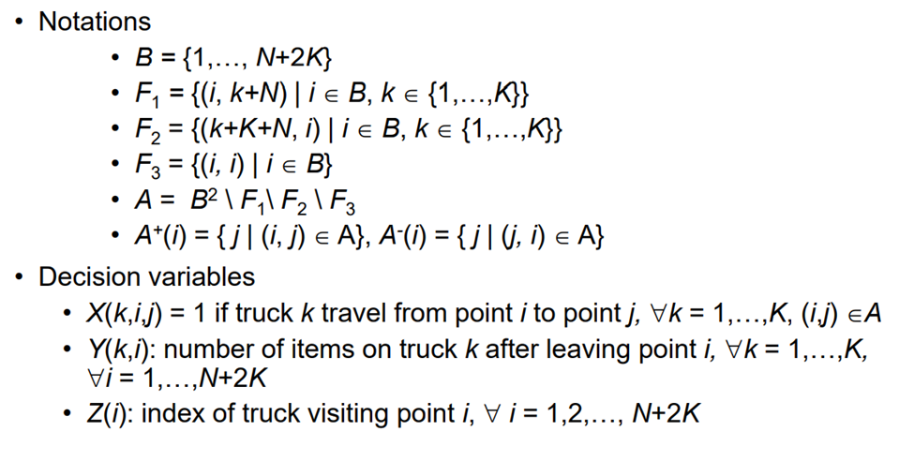

Slide 14
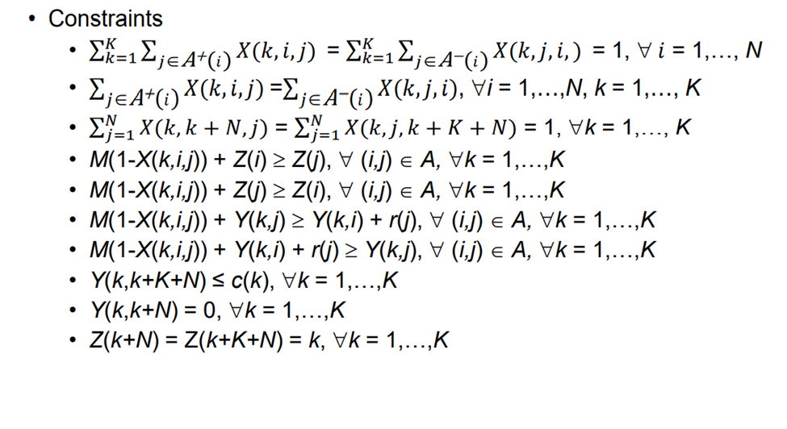
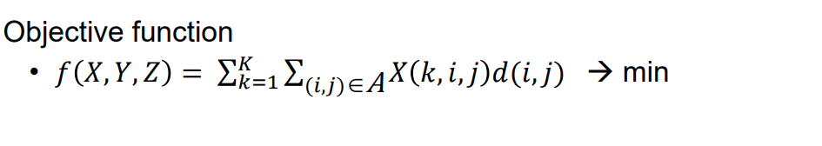

Slide 15
Problem of this method is how to add the specific set of h(i) hospitals constrains.
SOLUTION:
Z(t) is the index of truck visiting point i.
We will make sure there exist Z(j) which j in set H(i) have the same value as Z(i)
Algorithm:
- 1st: Adjust the value of Z(t): Before the value of Z(t) is{1,2,3,..,k}, now the value of Z(t) is Z(t)={n1,n2,..nk} which n1,n2,..,nk are different primes.
- 2nd: Add constraint: For j in H(i): multiple(Z(j)) % Z(i) ==0
Because all Z(t) are prime numbers so Z(j) % Z(i) ==0 if and only if there exist Z(j) which j in set H(i) have the same value as Z(i).

Slide 16
3, Greedy method:
Pseudo code for CVRP:
Generate_greedy_graph_of_CVRP
Greedy algorithm :
- choose car with biggest capacity
- then choose the node with the lowest cost
def greedy_search(): tier=[] cost=0 capacity=car_capacity if childnode is not visited: tier.append([childnode,cost_to_the_parentnode]) tier.sort(key=lambda x: x[1]) childnode=childnode(tier[0]) parentnode=tier[0] cost+=cost_to_the_parentnode capacity-=1 if capacity==0: return cost else: if childnode==depot: return cost else: continue

Slide 17
Greedy algorithm has the same problem as the CP method: How to add the specific set of h(i) hospitals constraints?
SOLUTION: We make the hospital in the set H(i) have higher priority by making their cost JUST like “tier list” below (Because the greedy algorithm always start with lowest cost node), and make sure it doesn’t affect much to the optimal path.
The Alpha make sure that the longer of ”not any node of H(i) chosen”, the smaller of their cost
def adjust_node_cost(): if every_node_in_H(i) is not visited: alpha=cost_of_i/sum_of_cost_of_visitednode else:#there exist node_in_H(i) visted: alpha=1 cost_of_every_node_in_H(i)=every_node_in_H(i)*alpha

Slide 18
4,Hill-Climbing
It only evaluates the neighbor node state at a time and selects the first one which optimizes current cost and set it as a current state.
Way to generate neighbours:
Exist problem:
- This is the simple hill_climbing which cannot fix the “local optimal” problem, we are still working for the backtracking hill-climbing.
- Backtracking technique can be a solution of the local maximum in state space landscape. It creates a list of promising paths so that the algorithm can backtrack the search space and explore other paths as well.
def generate_neighbours(): neighbours = [] for i in range(1, len(initial_state) - 1): for j in range(i + 1, len(initial_state) - 1): neighbour = initial_state.copy() neighbour[i] = initial_state[j] neighbour[j] = initial_state[i] if check_capacity(neighbour) == True: neighbours.append(neighbour) return neighbours

Slide 19
C. Data Analysis
N: 4 patient
M: 5 hospital
K: random from 2 to 5 vehicle
2 depot point in 11 x 11 matrix
The set of specific hospital H(i) is random

Slide 20
Sample No. | Exact cost | Greedy Algorithm |  | Metaheuristic Hill Climbing
 |  | f | t(s) | f | T(s)
1 | 189 | 193 | 0.001 | 189 | 0.1217
2 | 182 | 201 | 0.001 | 187 | 0.0509
3 | 188 | 196 | 0.001 | 193 | 0.0499
4 | 184 | 201 | 0.001 | 191 | 0.0379
5 | 189 | 194 | 0.001 | 195 | 0.0356
6 | 180 | 186 | 0.001 | 190 | 0.0519
7 | 195 | 207 | 0.002 | 196 | 0.0429
8 | 182 | 207 | 0.001 | 195 | 0.0399
9 | 189 | 194 | 0.001 | 195 | 0.0509
10 | 190 | 200 | 0.001 | 191 | 0.0619

Slide 21
D. Conclusion
CP and Bactracking :
Always give exact result
Easier to code than other methods.
But takes at least 4 seconds to excute (That’s 200 times greater than the “hill-climbing” and 4000 times for “Greedy algorithm”)
Metaheuristic Hill Climbing
Short execution time, often give the exact optimal result
Sometime the result is “local optimal result”, and distant from optimal result
Greedy Algorithm
Shortest execution time
But the result always close to optimal result, never equal

